Slide 1
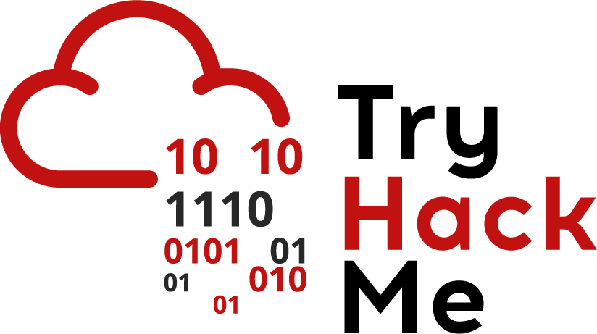


Cyber Kill Chain
Eng. Mahmoud Hassan

Slide 2
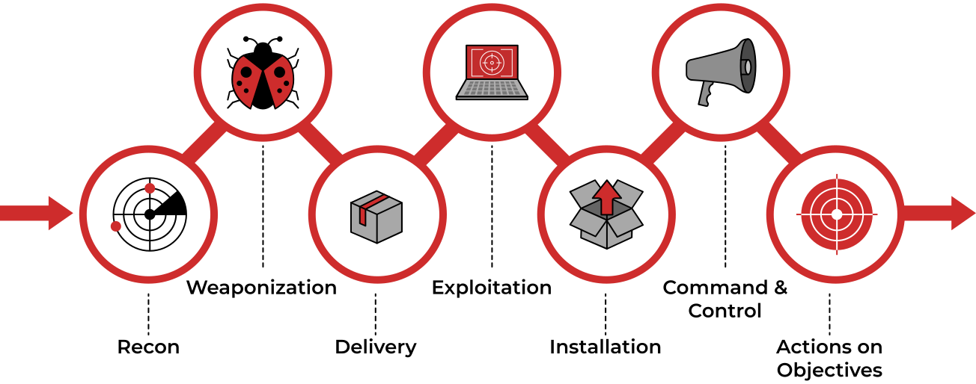
Cyber Kill Chain

Slide 3

Installation
What is Installation Phase?
The attacker establishes a persistent foothold on the compromised system. This ensures they can maintain access even if the initial vulnerability is patched or the system is restarted.
How Attackers Achieve Persistence?
Attackers use different techniques to maintain access, including:
1. Registry modifications: Changing system settings to ensure malware runs at startup.
2. Rootkits: Stealthy malware that hides malicious activity and grants deeper system access.
3. Trojanized software: Replacing or modifying legitimate applications to include malicious code.
4. Scheduled tasks & services: Creating tasks that automatically launch malicious processes.
5. Installing a Backdoor on the Victim’s Machine:
The attacker can use tools like Meterpreter (a Metasploit Framework payload) to install a backdoor on the victim’s machine.
Meterpreter provides an interactive shell that allows the attacker to remotely control the machine and execute commands.

Slide 4
Installation
How Attackers Achieve Persistence?
Attackers use different techniques to maintain access, including:
6. Installing a Web Shell on the Web Server:
A web shell is a malicious script written in web development languages like ASP, PHP, or JSP.
It is used by the attacker to maintain access to the compromised system.
Why Does an Attacker Need a Persistent Backdoor?
After successfully gaining access to a system, the attacker might lose connection for reasons such as:
1. Connection Loss:
Due to network issues or the system being shut down.
2. Detection of the Attack:
If the victim discovers the breach and removes the initial access point.
3. System Patching:
If the victim updates the system or fixes the vulnerability the attacker exploited.
In these cases, the attacker needs to install a persistent backdoor that allows them to return to the system even after losing initial access.

Slide 5
Installation
Timestomping Technique:
This technique allows the attacker to modify the timestamps of files, such as Modify Time, Access Time, Create Time and Change Time. The goal of this technique is to avoid detection by forensic investigators and make malicious files appear as part of legitimate programs.

Slide 6



Thank you
+201116735630
mahmoudhassan2947@gmail.com
www.linkedin.com/in/mahmoud-hassan-b4400b1b7

